Slide 1
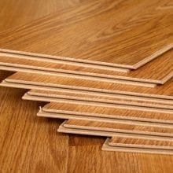
higher Design & Manufacture
Wood processes

Slide 2
Learning intentions & success criteria
Learning Intentions
To develop an understanding of the properties and uses of Wood in everyday objects.
Success Criteria
I can name 3 common wood processes.
Give examples of there possible uses.

Slide 3
Wood processes
Here are a few common processes you need to know about:
Laminating
Routing/Spindle Mould
Turning

Slide 4
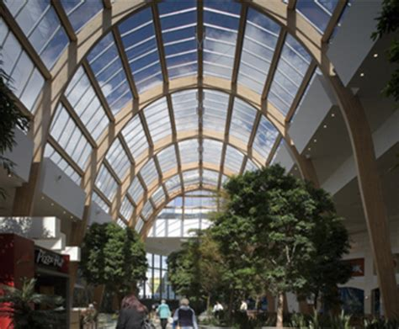
Laminating
Laminating (sometimes called glulam) is the process of gluing strips of wood together to form large sections
Can be used to build furniture or building structures
Can be used for most natural timbers and some manmade board such as chipboard

Slide 5
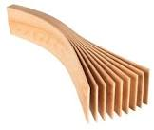
Laminating
Advantages:
Allows for much larger timber sections to be created than grow naturally
Cross section can be varied, allowing thicker parts where more strength is required
Disadvantages:
Can be very time-consuming to manufacture

Slide 6
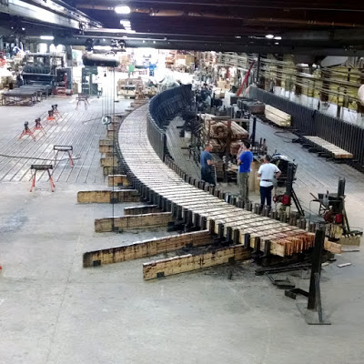
Laminating
Process
Sections of timber are cut out and glued edge-to-edge
PVA glue is most commonly used
Fast-setting adhesives can be used in industrial scale production
Glued sections are then cramped together until the glue dries
Sections can then be cut to shape
For curved shapes, a former must be used
Components are usually made longer than required and later trimmed
Video:
https://www.youtube.com/watch?v=TK_v01nqWTc

Slide 7
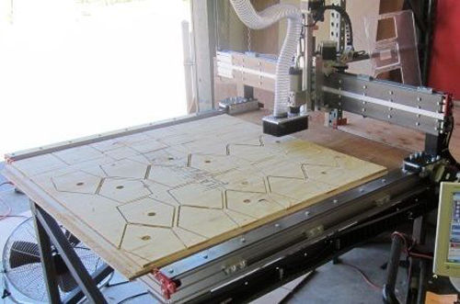
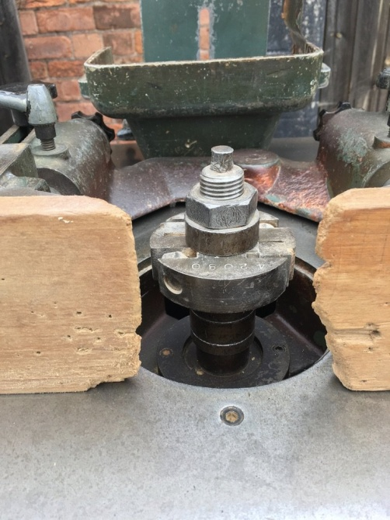
Routing & spindle mould
Uses a cutter which rotates at high speed to cut grooves or edge details in timber or manmade boards
Cutters can have different profiles to cut different grooves or edge styles
ROUTER: the work piece is fixed and the cutter moves
SPINDLE MOUND: this is fixed in place and the work piece is passed across the cutter (used for long straight work pieces)
Videos:
CNC Router: https://www.youtube.com/watch?v=vS3yILFOqAM
Spindle Mould: https://www.youtube.com/watch?v=z8m57FtK47w

Slide 8
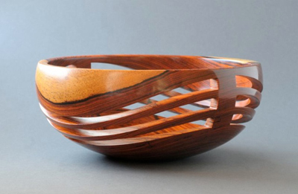
turning
Used to manufacture item by spinning wooden blanks on a lathe
The blank is then shaped using a variety of tools to produce items with an axis of rotational symmetry
Products include:
Vases
Banisters
Spindles
Handles
Bowls
Chess pieces

Slide 9
turning
Hardwoods give a better result and finish than softwoods
Irregular grain structure of hardwoods makes more interesting and aesthetically pleasing patterns
More intricate shapes can be made due to hardwood density
Examples of common woods used are:
Beech
Elm
Yew
Ash
Videos: https://www.youtube.com/watch?v=Nckqhfxabvs

Slide 10
Past paper question

Slide 11
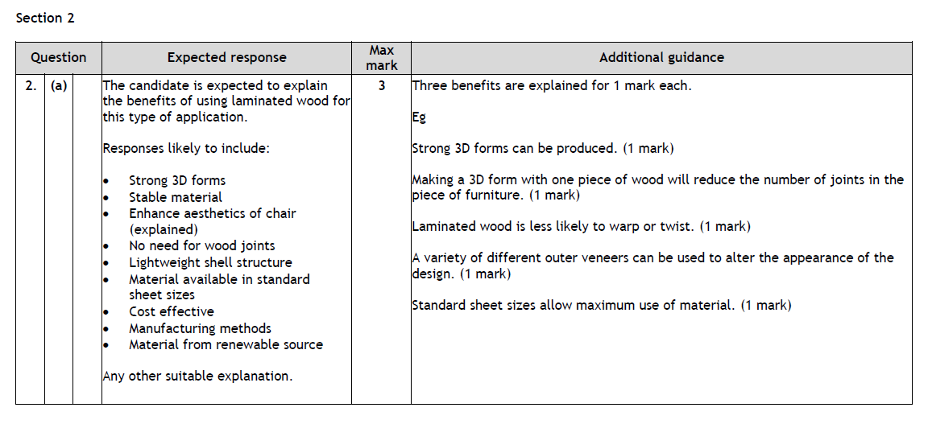
Past paper answers

